Slide 1
INDIAN ECONOMY ON THE EVE OF INDEPENDENCE

Slide 2
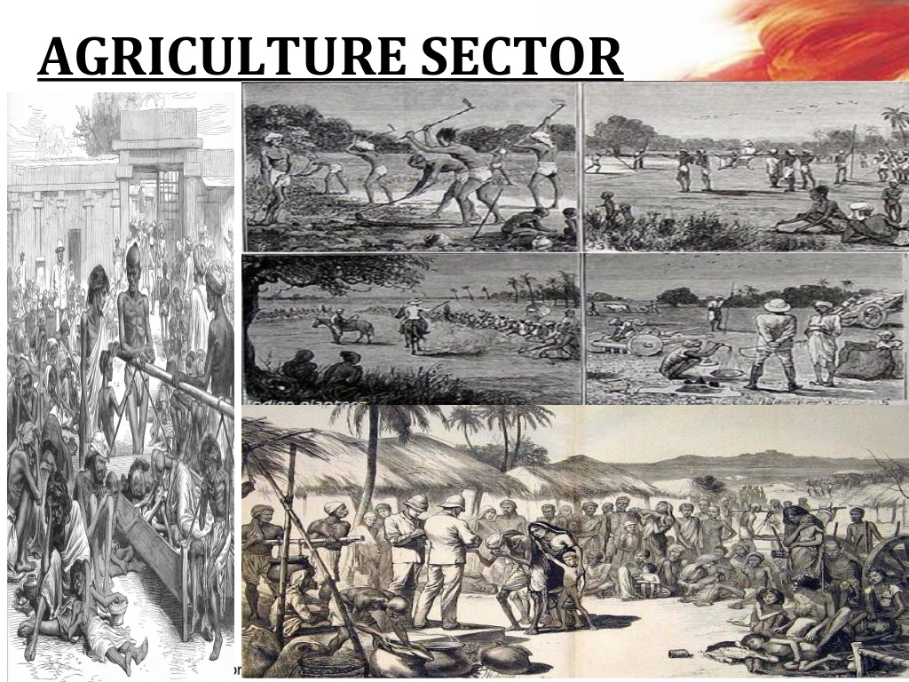

Slide 3
Salient features of India’s agricultural sector during the colonial period
Indian Agriculture was backward and stagnant during the British period.
(i) Agricultural productivity was very low. Subsistence agriculture was practiced in India. Methods of production were primitive.
(ii) Farming was completely dependent on rainfall. Irrigation facilities were not developed. So, crop failures were common.

Slide 4
Salient features of India’s agricultural sector during the colonial period
[iii) Most of the fertile land was owned by the Landlords. Most of the tillers were landless.
(iv) Most of the farmers were poor. They did not have enough capital to invest in agriculture. Most of them were illiterate and ignorant. They did not know about the modern farming methods.
(v) No investment was made in irrigation, flood control, terracing and desalinisation of soil.

Slide 5
Causes of India’s agricultural stagnation during the colonial period
(i) Land was owned by the Zamindars. They collected heavy rent from the farmers.
(ii) The Government forced farmers to cultivate cash crops. The British paid very low prices for these crops.
(iii) The profits earned from agriculture went in to the hands of the landlords. They used it for their luxurious life. So, there was no money to invest in the modernization of agriculture.

Slide 6
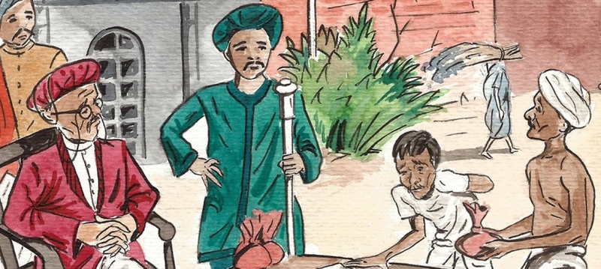
Zamindari System
Zamindari System was a land revenue system introduced by the British Government in Bengal.
Under this system Zamindar became the owner of the land.
He had to pay a fixed amount as tax to the Government
.
Zamindar collected heavy rent from the peasants who cultivated his land.

Slide 7
Commercialisation of Farming
Cultivation of crops for selling in the market is called commercial farming.
The British wanted raw materials for their industries. So, they encouraged the cultivation of cash crops like indigo, cotton, sugarcane etc.
The farmers were paid very low prices for their crops.
As they stopped the cultivation of food crops like wheat and rice, they had to buy food from the market. They did not have enough money. So, starvation started.

Slide 8
10/10

